Slide 1



Lead Scoring Case Study
Submitted by Abhinav Phirani, Abhishek Sharma
EPGPDS - C53

Slide 2

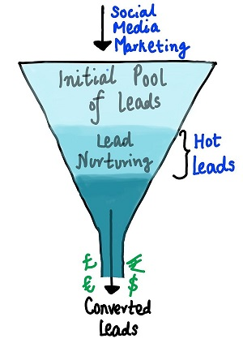
Problem Statement
X Education - an online edtech company selling courses is currently running at ~30% lead conversion rate. It currently uses several websites and google for bringing people to websites and then these leads are converted through watching videos, filling form, calls, SMS etc. Company also uses referrals. Company wants to identify more leads that have higher conversion rate, calling them 'Hot Leads'.
Lead Conversion Funnel

Slide 3
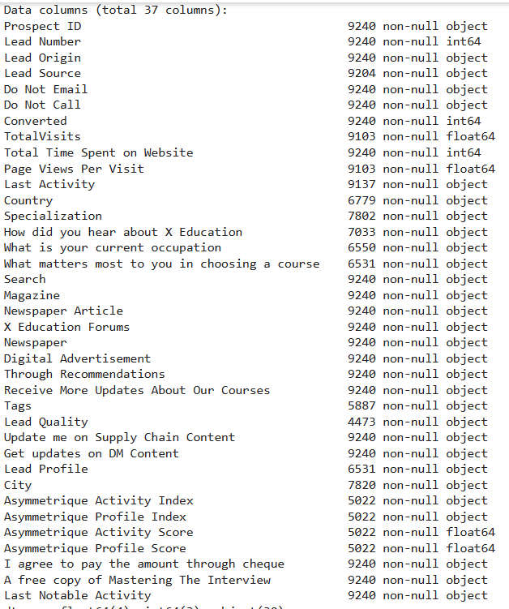
Data Description
~ 9000 data points on historical prospects and their conversion status
Key attributes impacting conversion like Lead Source, Total Time Spent on Website, Total Visits, Last Activity, Do not Email, Do not Call, Current Occupation status, Lead Origin, Country etc.
Target Variable : Converted – 0/1

Slide 4
End to end model development process
Stage 1: Importing libraries and read data
Stage 2: Data Cleansing
Stage 3: Data Encoding
Stage 4: Train-test split
Stage 5: Feature Scaling
Stage 6: Bivariate Analysis
Stage 7: Model Building
Stage 8: Model Validation
Stage 9: Predicting outcome on test data
Stage 10: Validating the performance parameters for test data

Slide 5
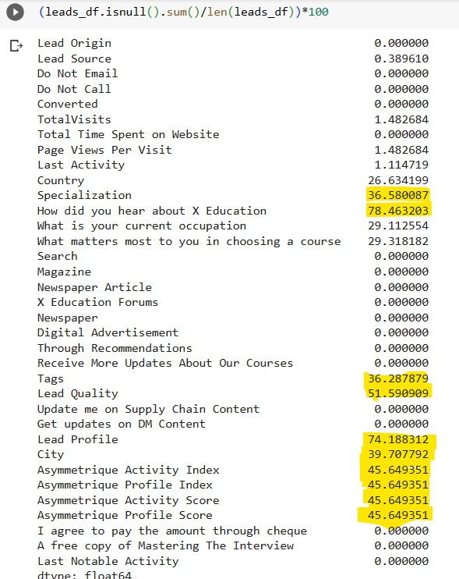
Data Cleansing
Removal of unique values ‘Prospect ID’ and ‘Lead Number’.
Drop the columns with > 30% null values

Slide 6


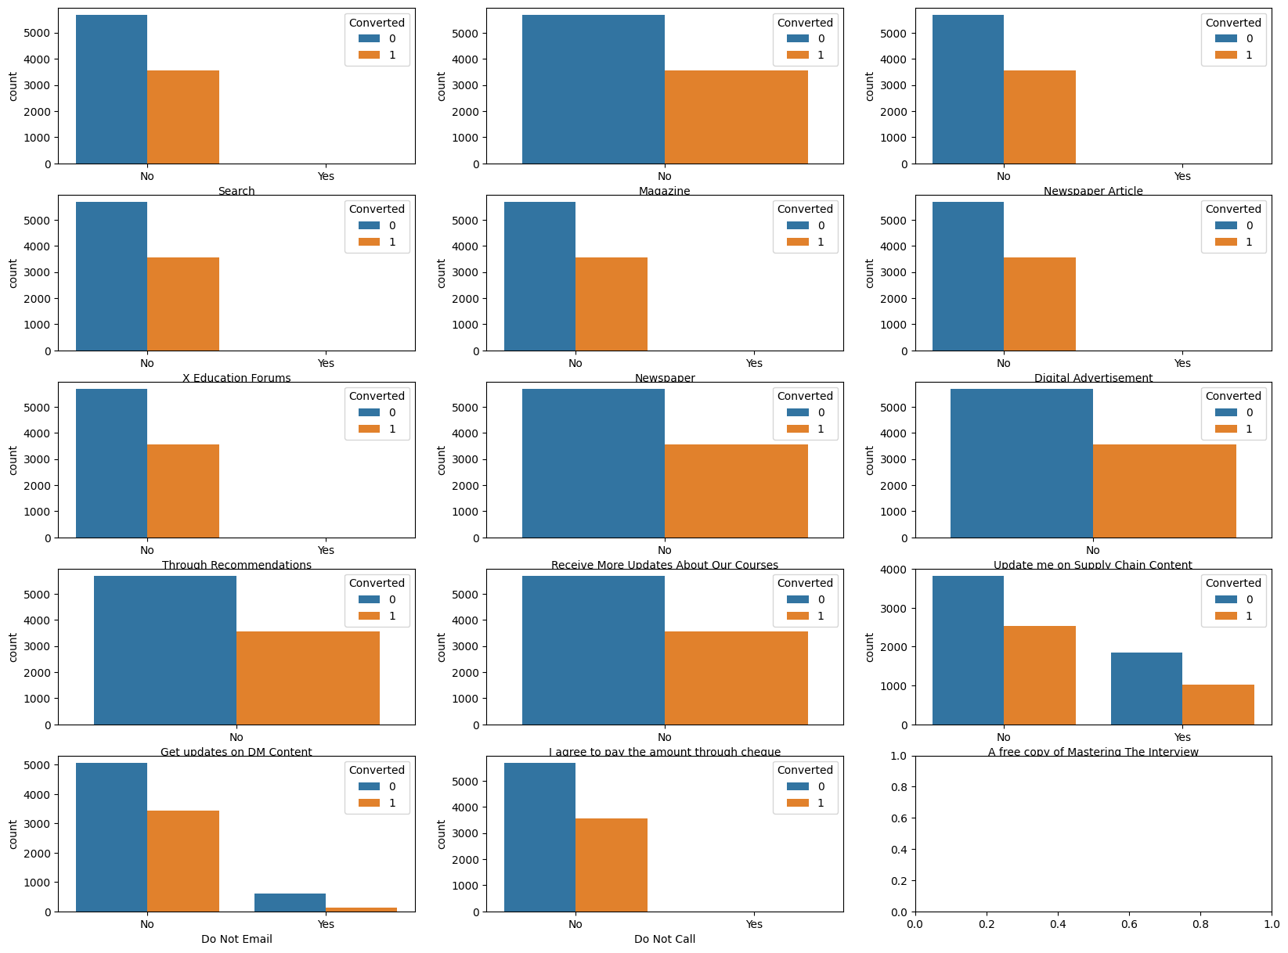

Remove the imbalanced variables, categorical data

Slide 7
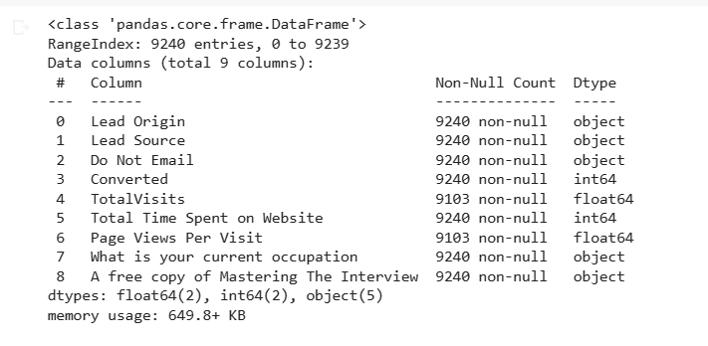
Remaining Attributes after dropping not required variables

Slide 8
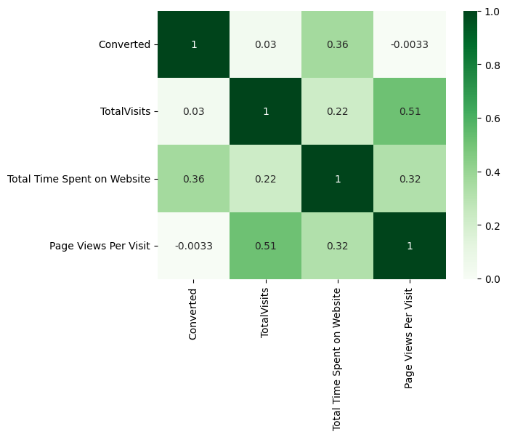
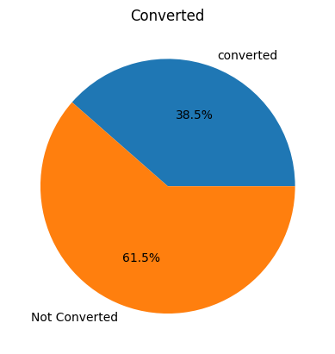
Numerical data analysis
Xs
Y

Slide 9
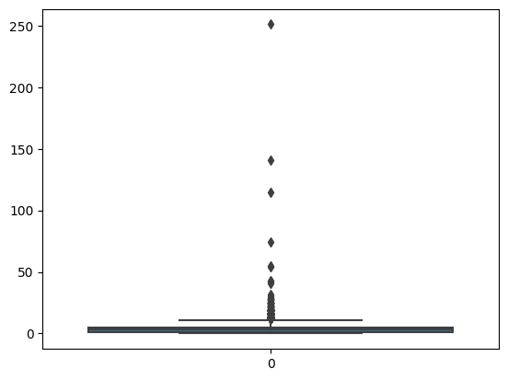
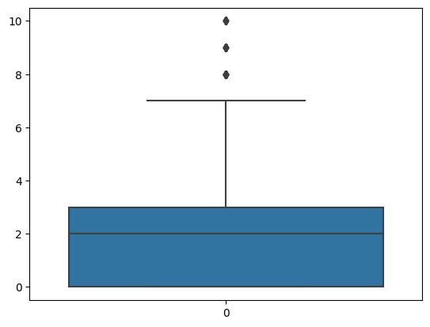
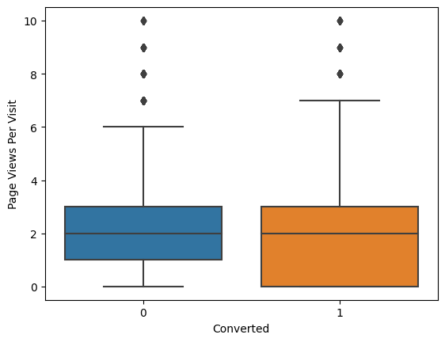
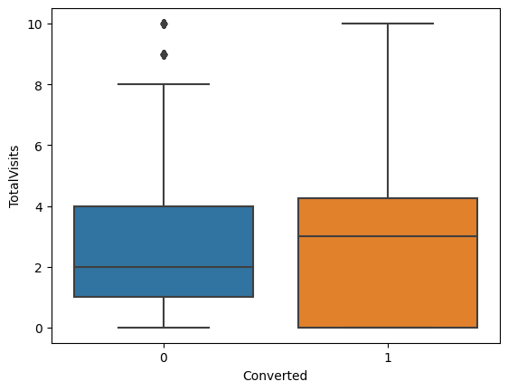
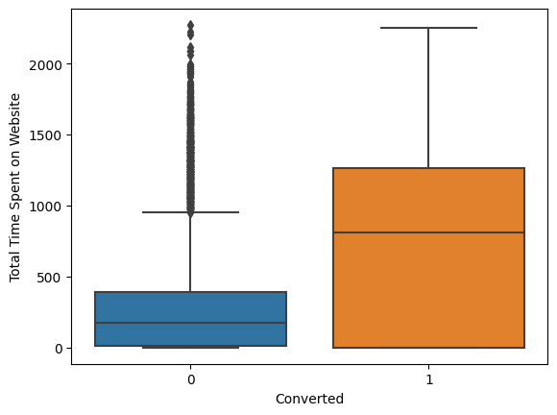
Check for Outliers and remove them

Slide 10
Data Preparation
Create Dummy variables
Encode Categorical variables to 0/1 and remove main columns
Test – Train split : 70% training data, 30% test data
Feature Scaling: - Standard Scaler to scale all variables

Slide 11
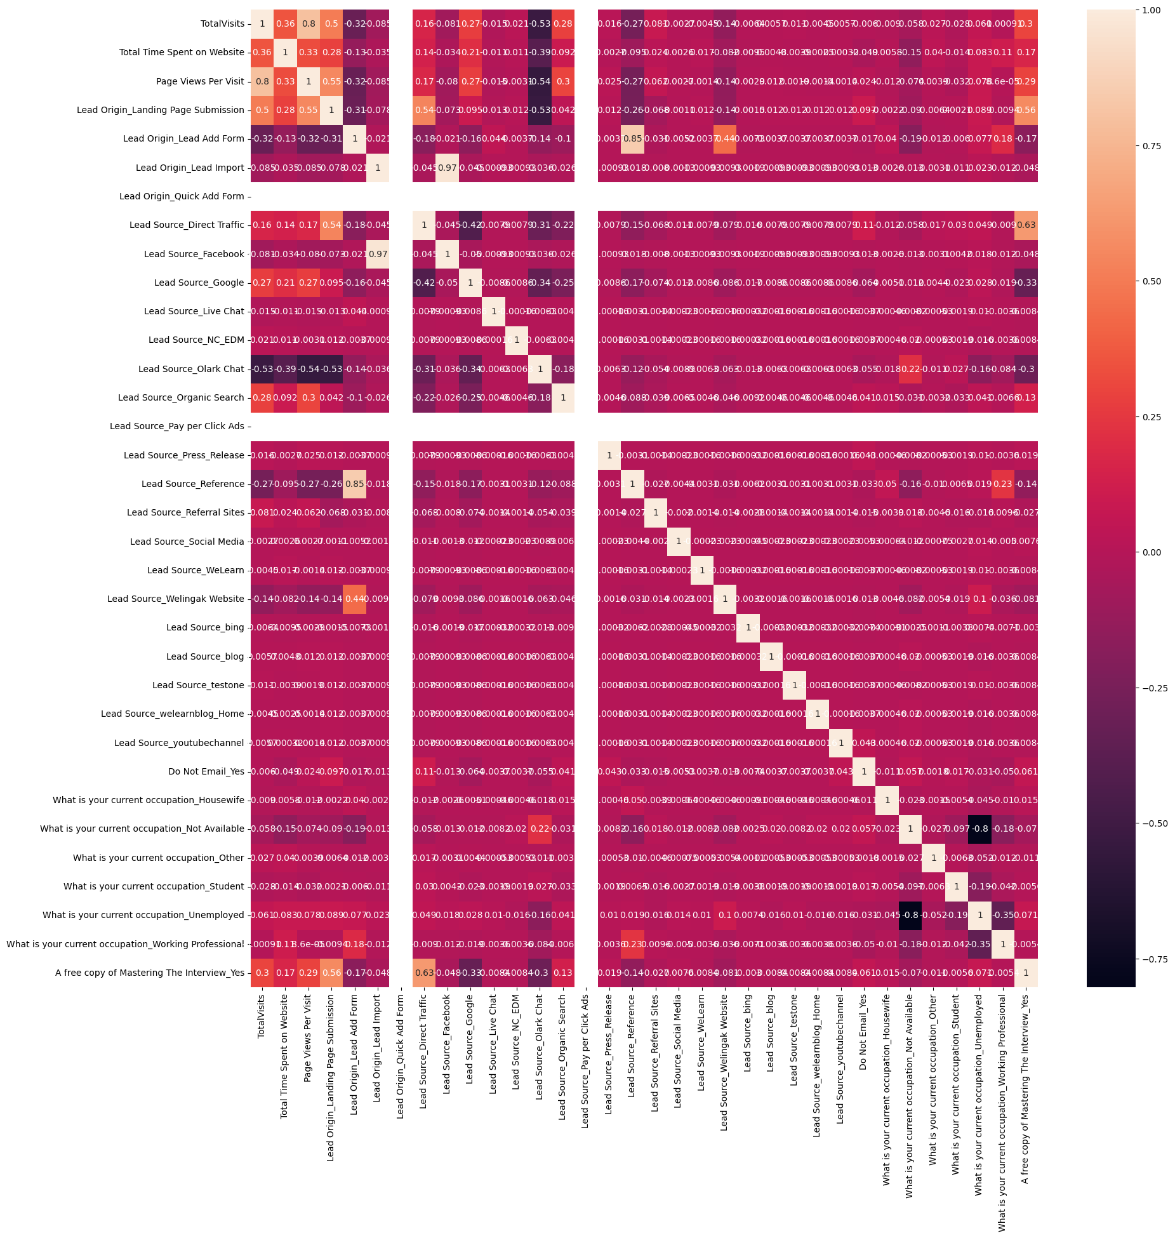
Correlation Matrix
Identify highly correlated parameters (>0.8 ) and remove them

Slide 12
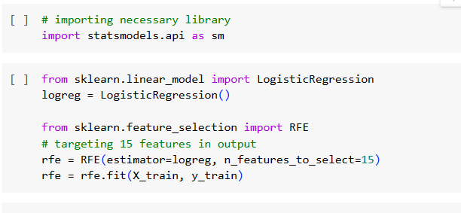
Model Building and Recursive Feature Elimination

Slide 13
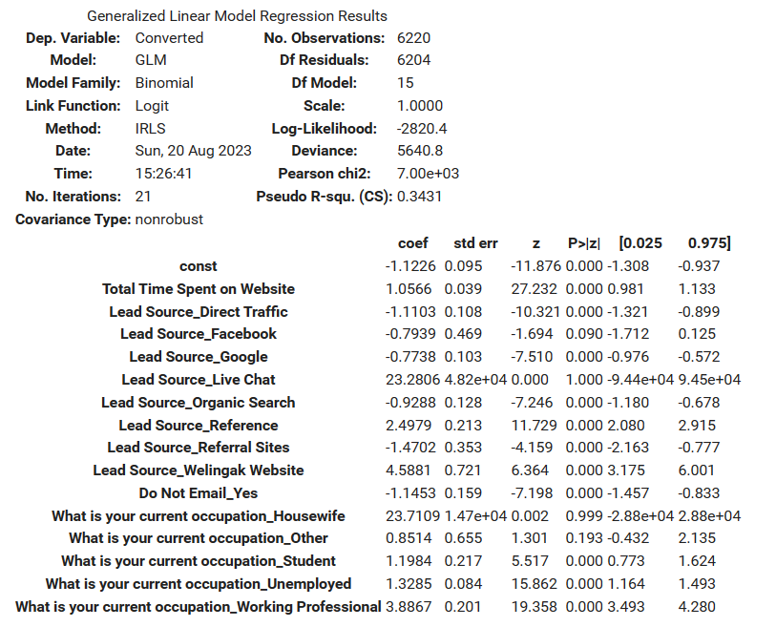
Fit the model and check P-value for each feature
Iteration 1: Remove variable with highest P-value and fit the model again and repeat till P-value is <0.05 for all variables

Slide 14
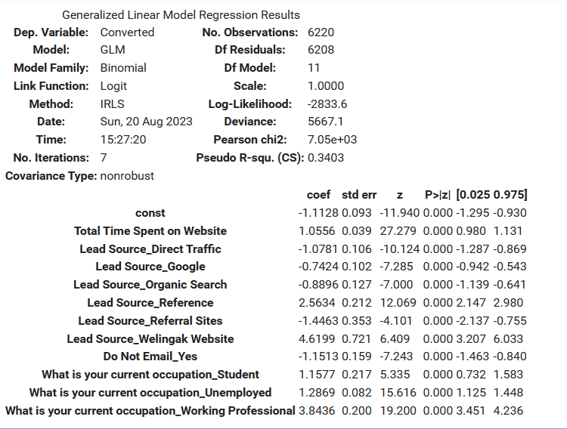
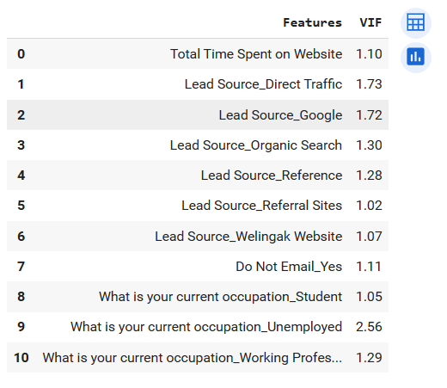
Iteration 5
VIF
P-value <0.05
VIF <5

Slide 15
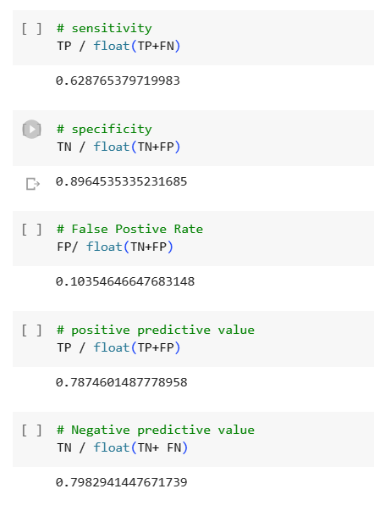

Predict Y-train and Check performance

Slide 16
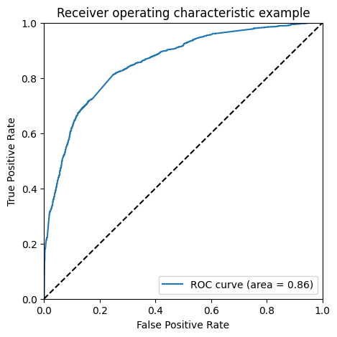
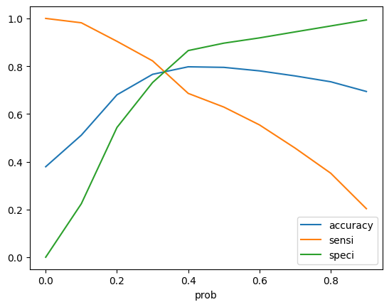
Draw ROC curve
optimal probability cut-off​
ROC 0.86 is close to 1 hence good fit
Optimal prob cut-off at 0.3

Slide 17
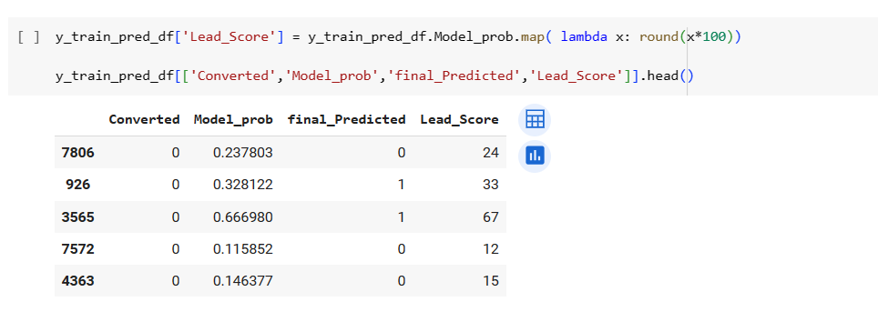
Calculate Lead score and predict accuracy based on Model probability calculation
Prediction Accuracy of 82.223%

Slide 18
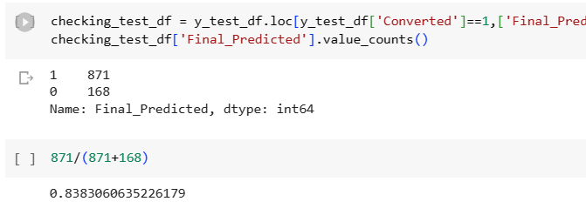
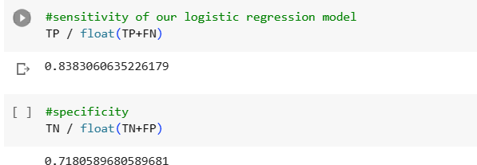
Test the same model on test data at cut-off prob of 0.3 and calculate performance

Slide 19
Conclusion
Our final logistic regression model has following attributes and respective coefficients

Slide 20
Subjective Questions -1
Which are the top three variables in your model which contribute most towards the probability of a lead getting converted?
Solution: Based on the coefficient values, the top three variables that contribute most are:
Lead Source
What is your current occupation
Do Not Email
What are the top 3 categorical/dummy variables in the model which should be focused the most on in order to increase the probability of lead conversion?
Solution: Again, based on the coefficient values, the top three categorical/dummy variables contributing most towards lead conversion are the same:
Lead Source - Welingak Website
What is your current occupation - Working Professional
Lead Source - Reference

Slide 21
Subjective Questions -2
X Education has a period of 2 months every year during which they hire some interns. The sales team, in particular, has around 10 interns allotted to them. So during this phase, they wish to make the lead conversion more aggressive. So they want almost all of the potential leads (i.e. the customers who have been predicted as 1 by the model) to be converted and hence, want to make phone calls to as much of such people as possible. Suggest a good strategy they should employ at this stage.
Solution: The final prediction is calculated based on optimal cut off value of 0.3. To maximize the chances of conversion, the company should reach to all prospects which have a conversion possibility, i.e. value of 1 and probability of 0.3.
Similarly, at times, the company reaches its target for a quarter before the deadline. During this time, the company wants the sales team to focus on some new work as well. So during this time, the company’s aim is to not make phone calls unless it’s extremely necessary, i.e. they want to minimize the rate of useless phone calls. Suggest a strategy they should employ at this stage.
Solution: Post meeting the target if we are able to run through all the calls at optimal cut-off probability of 0.3, we need to maximize the positives, even if the total number of calls go down. Therefore, we need high sensitivity, even if conversion probability is low. We can slowly start moving from 0.3 probability to 0.2 and 0.1 and start calling all possible prospects with value equal to 1.

Slide 22
Thank you

